Slide 1

Optimising CCD IITM Sales Through Data Analysis
BDM Capstone Project Presentation
Renee K. Paturi
22f2001379

Slide 2
Executive Summary & Introduction
Goal: Analyse ~90 days of CCD IITM transactions (~800 entries)
Unique Context: Subsidised pricing under CMGFS policies
Key Findings:
◦ Food contributes ~47% of revenue
◦ 20% products account for >80% of sales
◦ Weekend & evening peaks
◦ Weak snack-beverage correlation (cross-selling potential)
Overall: CCD IITM acts more like a fast-food provider than a coffee-first brand

Slide 3
Data & Methodology
Data: 800 transactions across 90 days (Aug–Dec 2024)
Collected via bills → transcribed into Google Sheets
Key Columns: Date, Category, Sub-category, Item, Qty, Net Sales (₹)
Methods:
◦ Descriptive statistics
◦ Pareto (80/20)
◦ Time-series analysis
◦ Pearson correlation
◦ Forecasting (Holt-Winters, SMA)

Slide 4
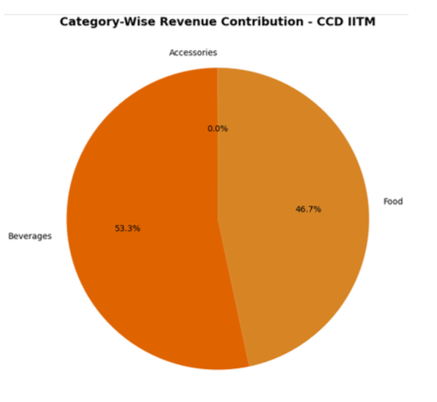
Key Finding 1: Revenue Contribution & Pareto Effect
Food vs Beverages nearly equal (~47% vs 53%)
<= 20% products drive >80% of revenue
Coffee alone contributes ₹14 lakhs+

Slide 5
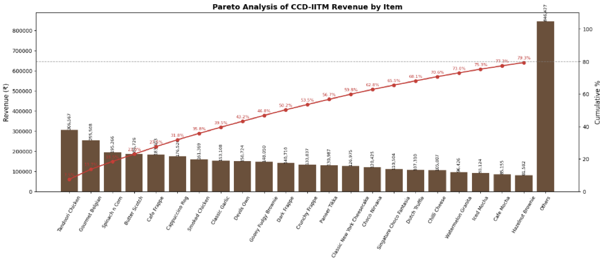
Key Finding 2: Sales Trends & Variability
Net sales skewed, mean ₹523, wide variability
Weekend >350 customers vs 200–300 weekdays
Evenings busiest hours

Slide 6
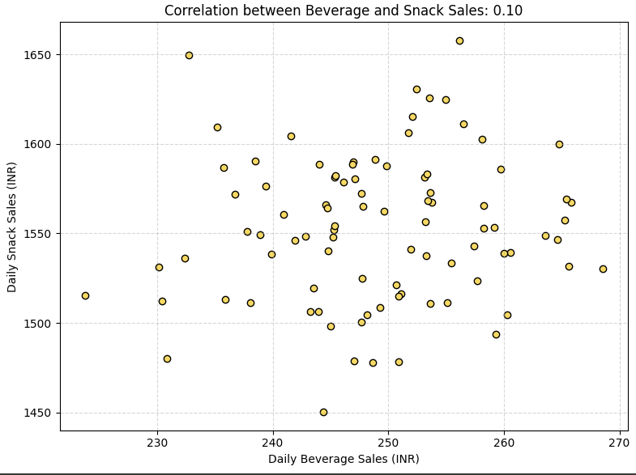
Key Finding 3: Cross-Selling Potential
Snack-beverage correlation weak (r=0.10)
Still potential for combo offers
Eg: Iced Mocha + Tandoori Chicken Sandwich

Slide 7
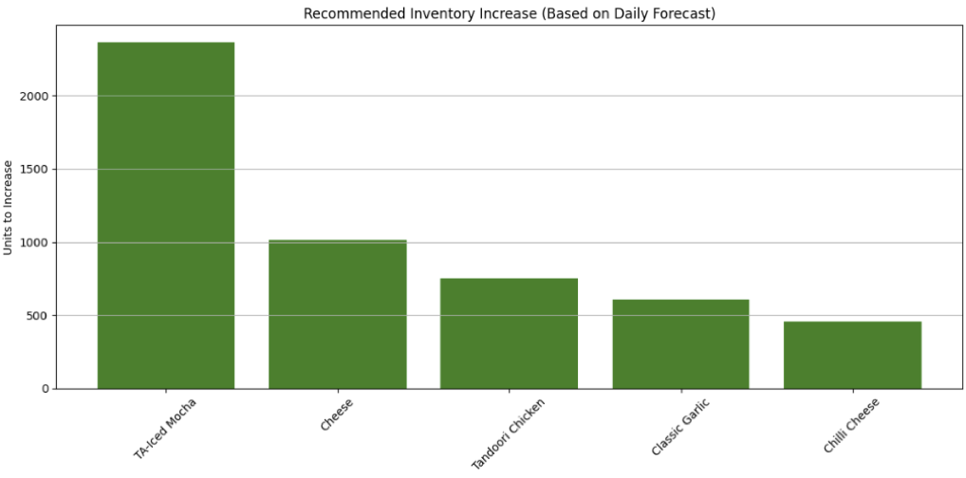
Forecasting & Inventory Optimisation
Holt-Winters & SMA show good accuracy
High gaps: Iced Mocha, Cheese, Tandoori Chicken
Scale inventory to avoid stockouts

Slide 8
Strategic Recommendations (Data-Driven)
Prioritise top SKUs, rationalise low-sellers
Balance food & beverage positioning
Align staff/inventory with peaks
Launch targeted combos
Forecast-driven stock management

Slide 9
Strategic Recommendations (Personal Observation)
Display items more clearly
Upsell cheese proactively
Promote bottled water sales
Build rapport with students
Scale stock for campus fests (e.g., Paradox)

Slide 10
Conclusion & Next Steps
CCD IITM = fast-food oriented
Few items dominate sales (Pareto effect)
Clear peaks: weekends, evenings
Combo offers = revenue growth opportunity
Next Steps: Monitor trends and apply recommendations
Power BI Dashboard: [Power Bi Dashboard]
Link to the dataset and Analysis [Dataset]
THANK YOU!

